Slide 1
8th Grade Parent Night
February 13, 2024

Slide 2
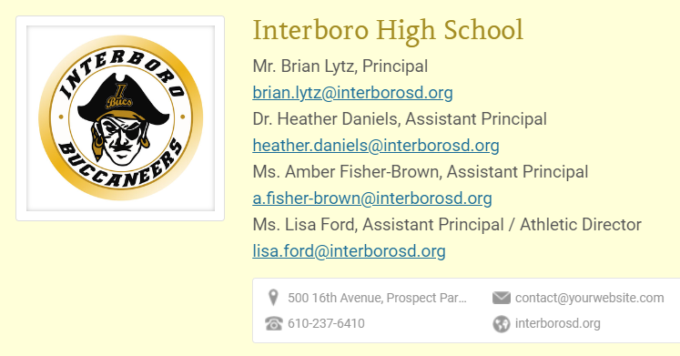
High School Administration

Slide 3
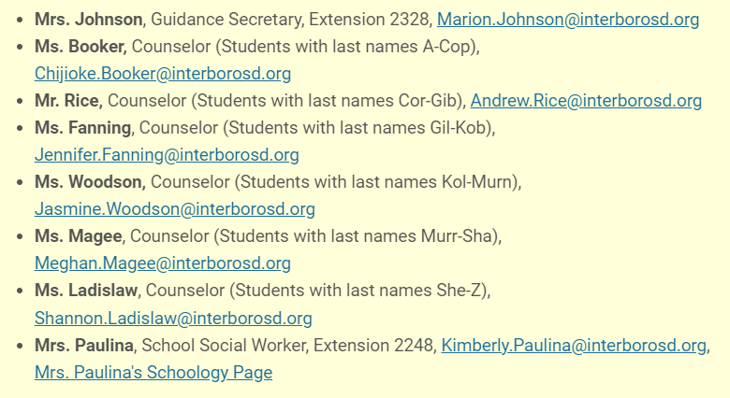
GUIDANCE COUNSELORS

Slide 4
GUIDANCE COUNSELORS
The counseling department can help you with:
Course Scheduling
Graduation Planning
PSATs, SATs, ACTs, and ASVAB
Monitoring Academic Progress
Problem solving and communication skills
Individual and Group Counseling
Study Skills and Time Management
College and Career Counseling
College Visits

Slide 5
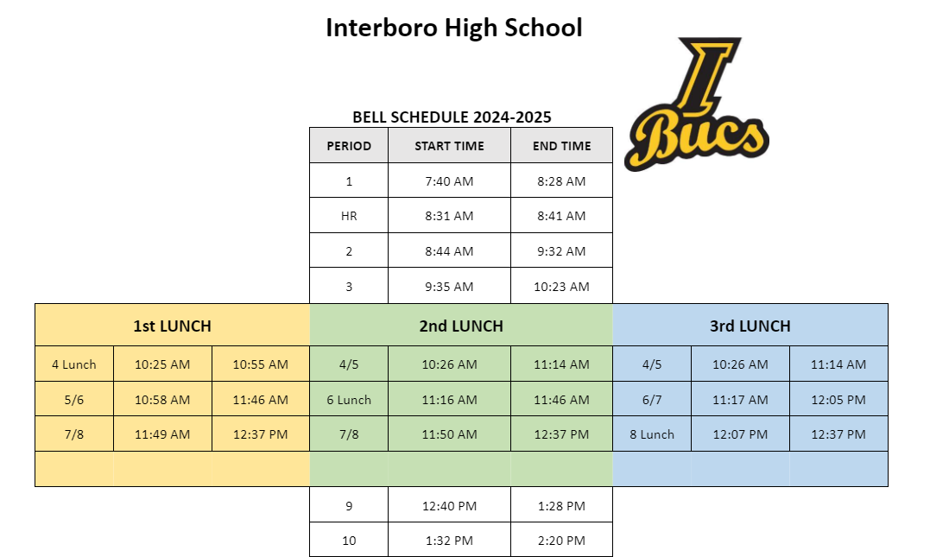
Bell Schedule

Slide 6
How your grade is calculated
Your Marking Period course grade calculation:
60% Assessment
40% Assignments
Your Final Grade calculation:
20% each Marking Period
10% Midterm
10% Final Exam

Slide 7
How can I be successful?
Ask Questions
Check Schoology & eSchool
Get Help If You Need It
Stay Organized
Participate in the BUCS Program
Get Involved!

Slide 9
GRADUATION REQUIREMENTS
English Social Studies Science Mathematics Health PE Electives Total: | Required 4 4 3 3 .5 1.0 7.5 23 | Recommended 4 4 4 4 .5 1.0 8.5 27
The Clock Starts Now!

Slide 10
WHAT ARE THE KEYSTONES exams?
The Keystone Exams are administered in 3 areas:
Algebra I
Biology
English Literature
The Keystone Examinations are designed to be an “end of course” examination. When a student completes a Keystone related course (Algebra I, Biology, English 10) he/she will take the Keystone Exam.

